Slide 1
Department of corrections
Exploratory data analysis
By
Chethan Nemmadhi

Slide 2
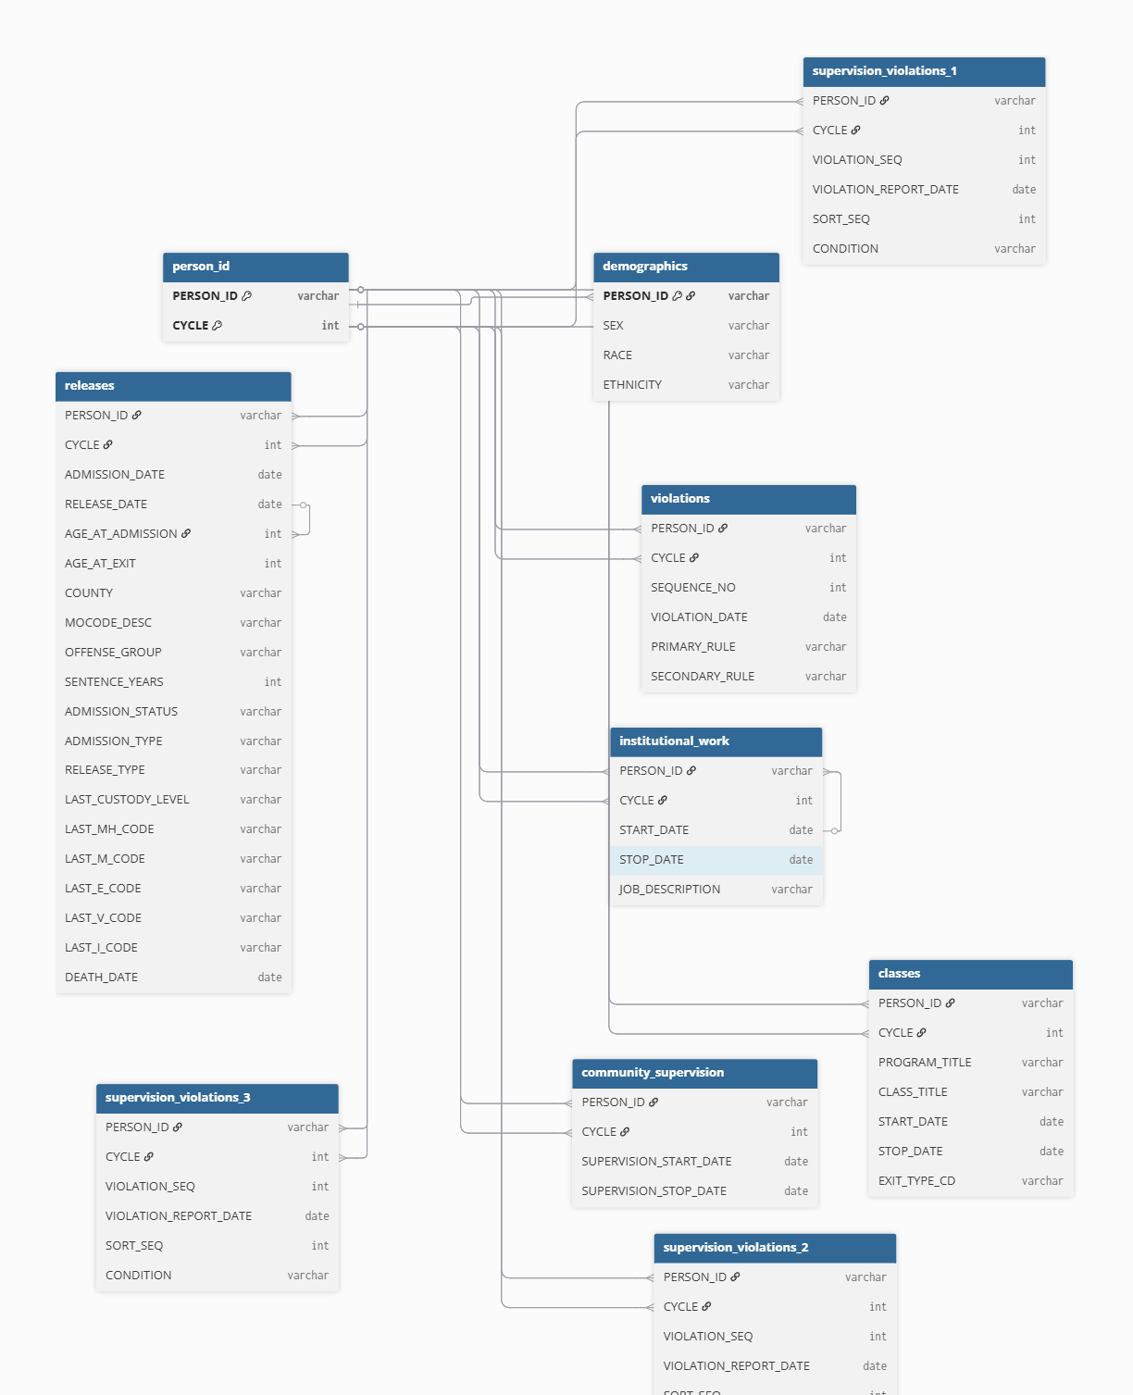

Slide 3
Population Characteristics of Incarcerated Individuals
Racial distribution shows the population is predominantly White (75%) and Black (24%), with minimal representation from Indigenous, Asian, and Unknown groups.
The sharp decrease after 2019 aligns with broader criminal justice reform efforts and public health measures during COVID-19.
These population shifts likely had major implications for facility capacity planning, staffing, and budget allocation.
Disparities in incarceration may persist even as total counts drop, highlighting the need for targeted intervention.

Slide 4
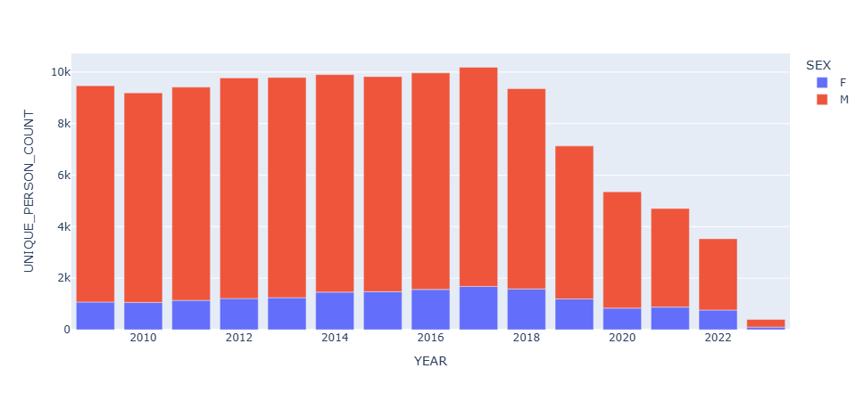

Slide 5
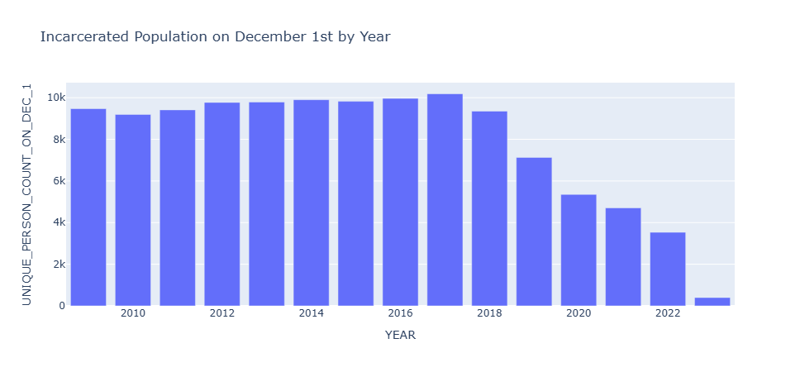

Slide 6
Patterns in Violation Behavior Over Time
Violation trends peaked between 2012 and 2017, highlighting a sustained period of operational stress and potential behavioral volatility inside institutions.
Recurring top violation codes (e.g., 20.1, 19.1) point to persistent behavior patterns a clear opportunity to design targeted interventions and evaluate their effectiveness over time.

Slide 7
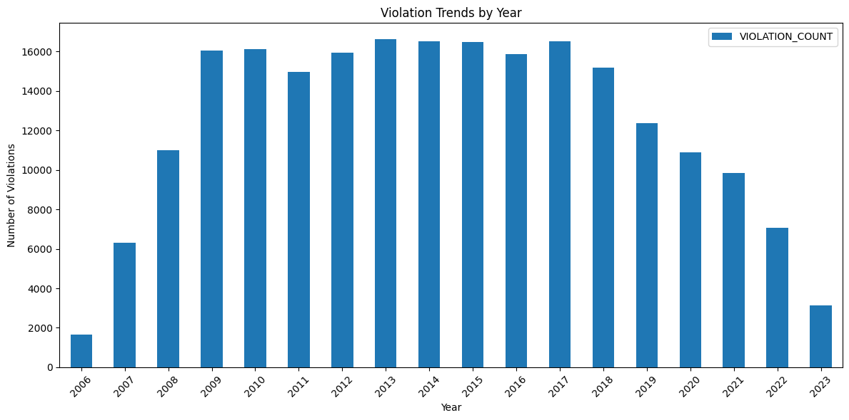

Slide 8
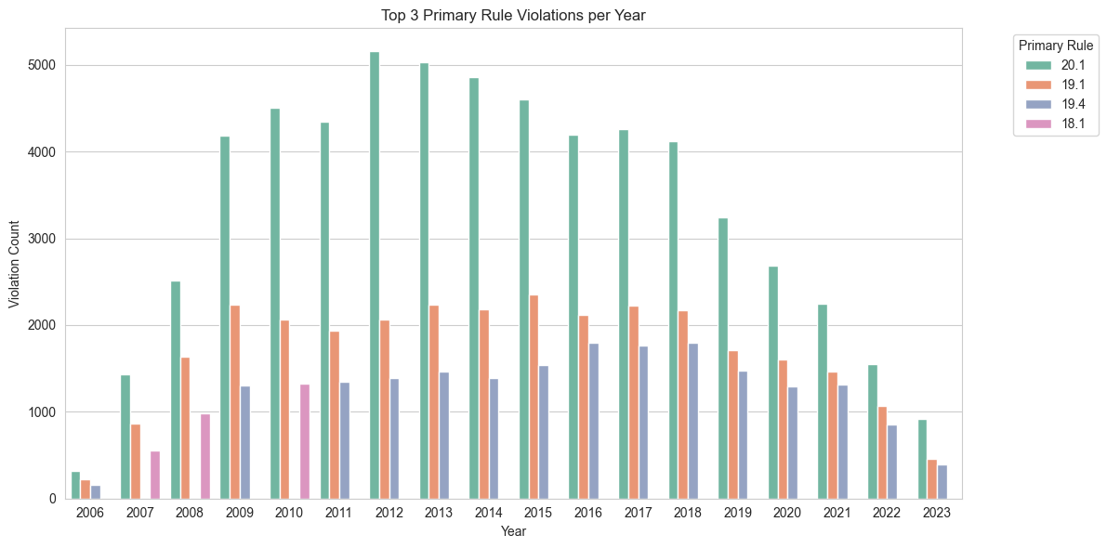

Slide 9
Most Popular Classes & Completion Rates
Pathway to Change dominated enrollments across most years, showing institutional reliance on cognitive restructuring.
High-performing programs like High School Equivalency and Short Term Treatment also showed strong SFL rates — reflecting their potential role in rehabilitation and reentry success.
Substance Abuse Education had lower completion rates historically (as low as ~20%), suggesting challenges in engagement or program fit.

Slide 10
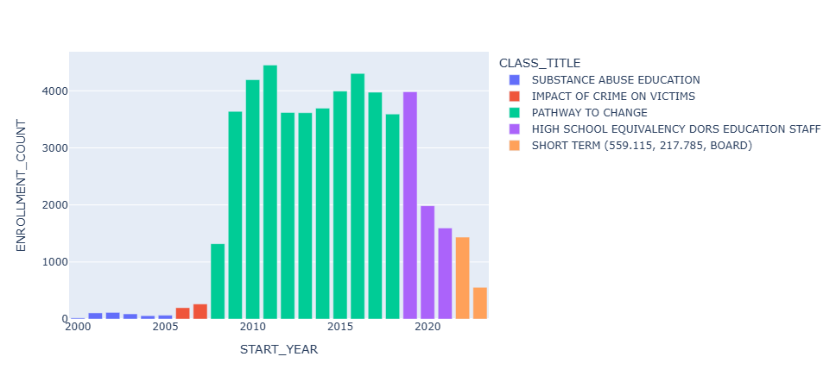

Slide 11
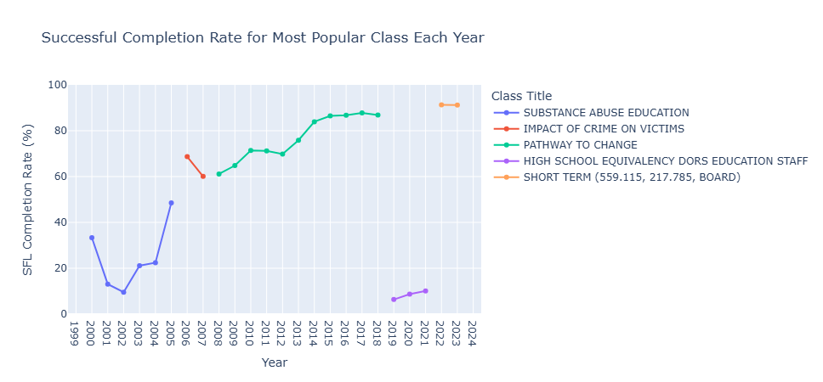

Slide 12
Correlating Institutional Work with Conduct Violations
Inmates who participated in institutional work had a lower average violation rate (9.29) than those who didn’t.
Roles like janitorial services, maintenance, or tutoring may instill routine and accountability, helping reduce infractions.
Expanding work assignments may serve as a cost-effective tool to reduce misconduct without extra surveillance or enforcement.
Preliminary patterns suggest that individuals with longer or repeated job roles tend to maintain lower violation counts indicating potential long-term behavioral reinforcement.

Slide 13
Recidivism Within Two Years of Release
Out of 81,953 individuals released, 15,370 returned to prison within two years that’s an 18.75% recidivism rate.
Most returns happened within the first 1–1.5 years post-release, pointing to a critical intervention window.
Early re-entry flags potential gaps in supervision, job placement, or support service.
Tracking this over time can inform the impact of rehabilitation policies and funding allocations.

Slide 14
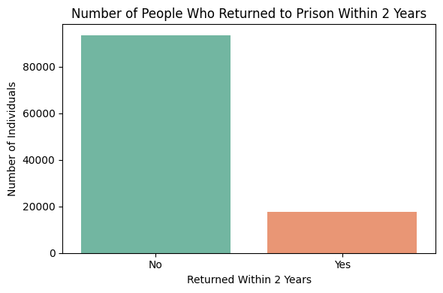

Slide 15
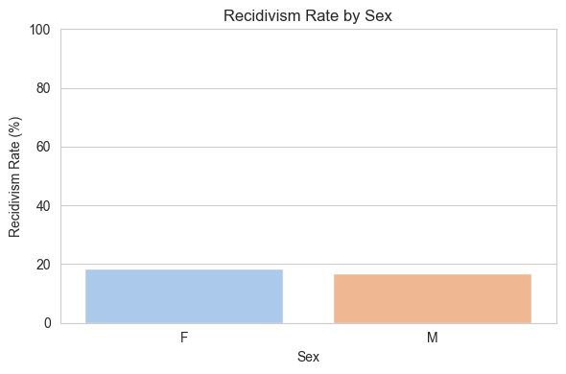

Slide 16
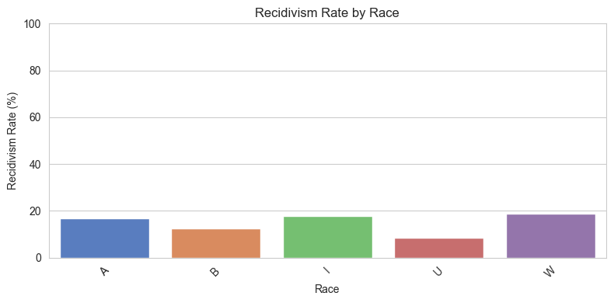

Slide 17
Data Quality
Inconsistent date ranges across programs and violations in violations exist for cycles where release dates are missing or outside realistic timelines.
Unclassified offense groups and missing class completion outcomes suggest incomplete tracking of program effectiveness.
Different naming conventions and column formatting (casing, extra spaces) required standardization can lead to analysis errors.

Slide 18
Data that suggest a change in policy
Sharp declines in violations and population after 2019 may reflect COVID-related early releases or policy changes on sentencing.
Institutional work participation dipped during specific years, suggesting possible staffing policy changes or program restrictions.
Changes in supervision violation types over time increase in technical violations suggests evolving enforcement priorities.

Slide 19
Future Research
Future analysis can explore how mental health, medical, and educational scores correlate with violations, program success, and recidivism
Pre-release flag system could help staff identify individuals who haven’t completed required programs.
Standardizing program labels and completion fields would greatly improve tracking over time
Dashboards at the facility level could spotlight violations, returns, and completions to support real-time decisions.
Institutional work programs seem to correlate with fewer violations, so evaluating and potentially expanding them could be a strategic win."

Slide 20
References
https://doc.mo.gov/sites/doc/files/2018-01/White-Book.pdf
https://doc.mo.gov/sites/doc/files/2018-01/offender-rulebook-9-12-14.pdf
https://onlinelibrary.wiley.com/doi/full/10.1002/pam.22529

Slide 21
Questions?

